Slide 1
What is an API?
Your new favourite three letters (or your money back)
Chris Hammond: chris@ucl.ac.uk

Slide 2
Who am i?
Chris
4th Year Computer Science at UCL
Product Manager of the UCL API (https://uclapi.com)
Ex-TechSoc committee and co-founder of Porticode

Slide 3
Before we begin!
Download Postman https://www.getpostman.com
We’ll use this later
It’s a pretty big app for lots of people to download at once, so get it downloading whilst I speak ☺

Slide 4
First Principles
API: Application Programming Interface
APIs define how a program can be used by another program. They make programs work together.
Would be impractical / crazy / insecure / a total mess to allow one program written by one person to be able to use another program’s database directly
Insecure
Unreliable
What if the code changes on either side?
Common datatypes:
JSON (JavaScript Object Notation) – more common and modern. Easier to handle.
XML (Extensible Markup Language) – less common, more outdated. Tougher to handle.

Slide 5
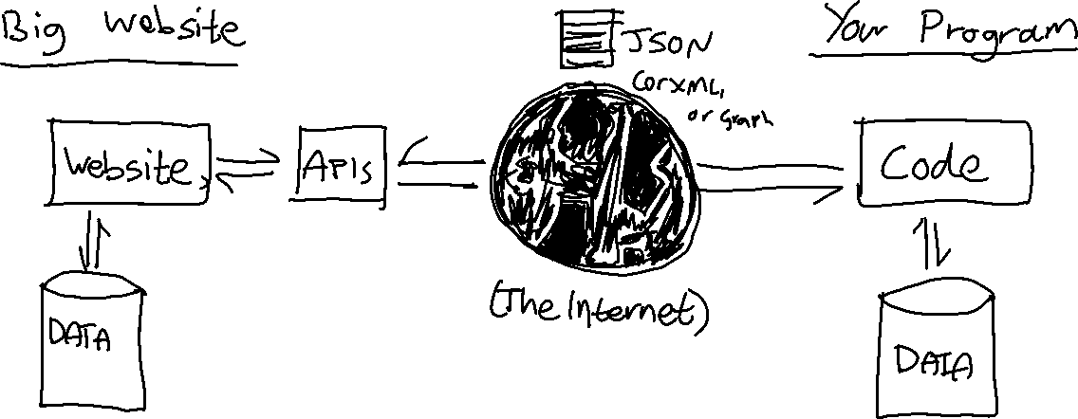
(Questionably) Pretty Pictures Help Everything
Data is exposed via APIs so that your code doesn’t have to read another program’s (or website’s) database that has all of the users’ data in it.

Slide 6
Have some rest
APIs are usually known as RESTful, meaning they are stateless
This means you:
Want some information
Make a request for it (to an endpoint, e.g. a web address)
Wait for a response
Make use of that to do something useful
The APIs you’ll use will run over HTTPS. In other words, they are just like websites. You’ll see more in a second when this comes together hopefully neatly and in a not too confusing way.

Slide 7
Types of Web Requests (HTTP Verbs)
GET Your plain old “normal” requests (e.g. browsing to google.com) and GETting the webpage. Parameters go in the web address after a question mark.
POST When you fill out a form on a website (like a login form) and hit ‘submit’ but the stuff you typed doesn’t go into the web address, the browser will make a POST request.
PUT / DELETE / some other niche ones Some APIs are strict about which verb you use for which operation.

Slide 8
Let’s Have a Go!
SWAPI: The Star Wars API https://swapi.co
All data on all Star Wars characters, planets, etc.
Data is in JSON format
We’ll consume it in Postman and then learn how to program with it!

Slide 9
A SWAPI Request
All requests are in GET format (which is nice and easy to work with, and you can even test in your browser!)
Examples:
https://swapi.co/api/planets/1 Gets information on the first planet
https://swapi.co/api/people?search=r2 Searches for all people in Star Wars with a name including the string r2 The search parameter at the end is called a query parameter. Sometimes they’re just referred to as query params, and they are a way of specifying settings.

Slide 10
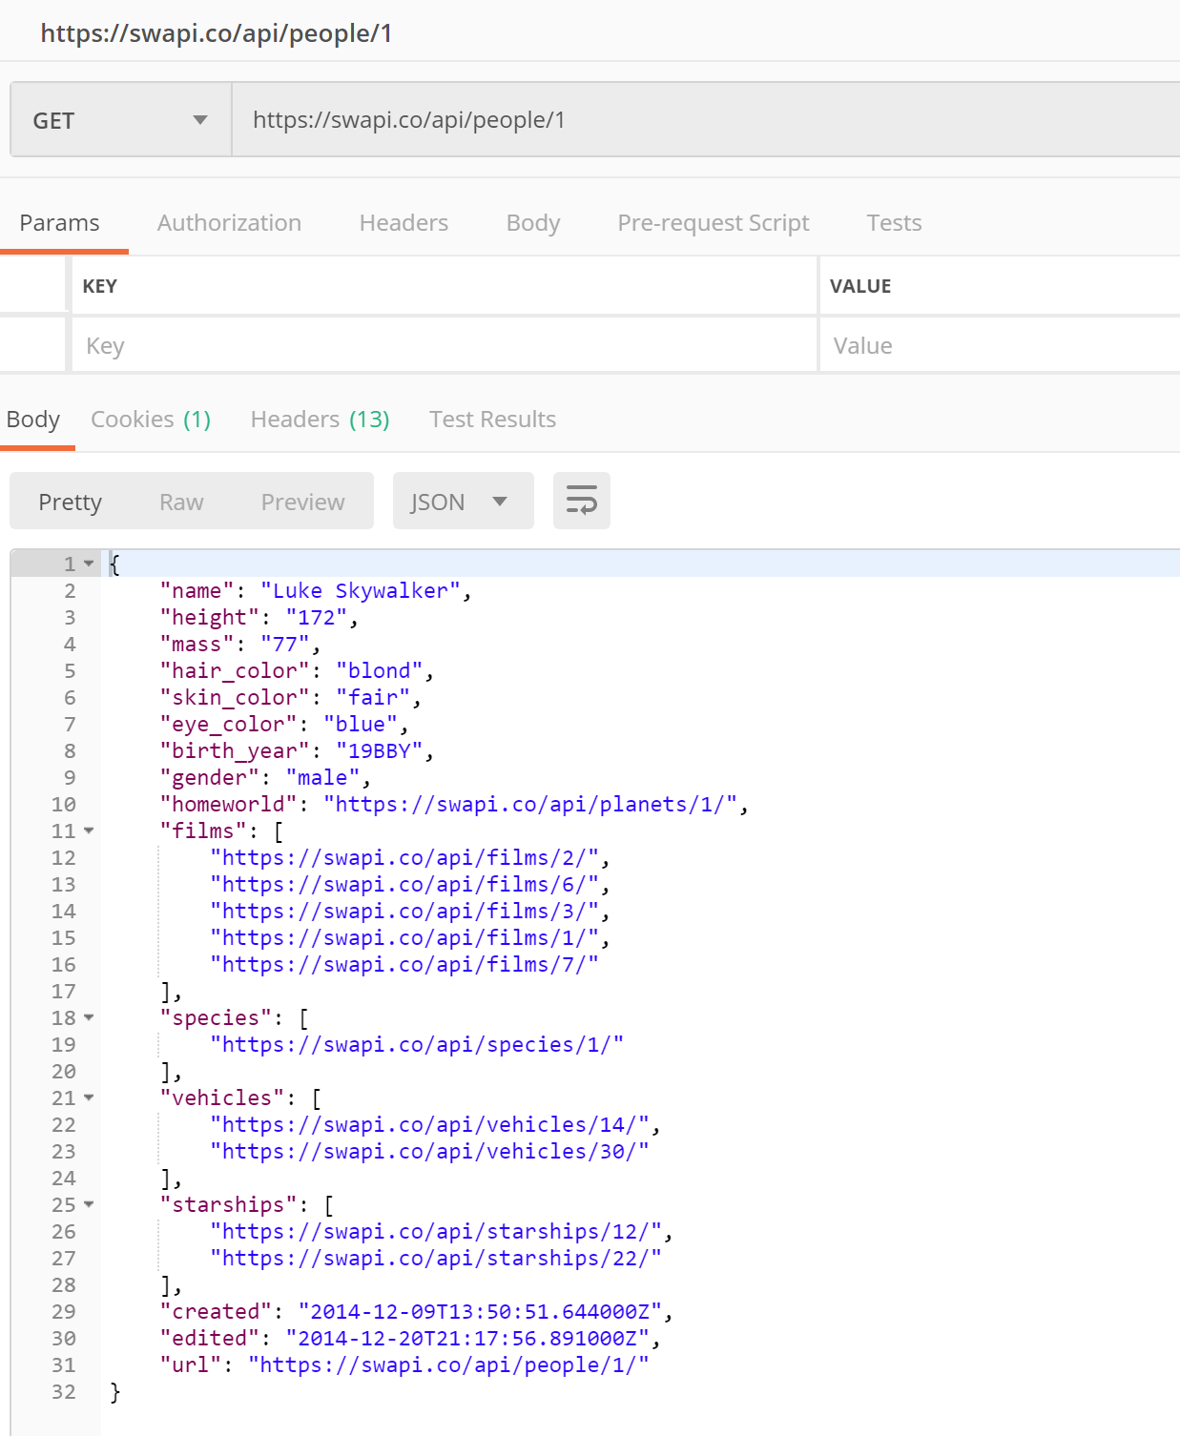
The Response
HTTP Method is GET (default)
The API Endpoint Requested
Response returned as a JSON object
Structure of JSON data:
{ … } Dictionaries. Made up of keys and values.
“ … “ Strings: just ordinary text
[ … ] Lists: comma delimited items

Slide 11
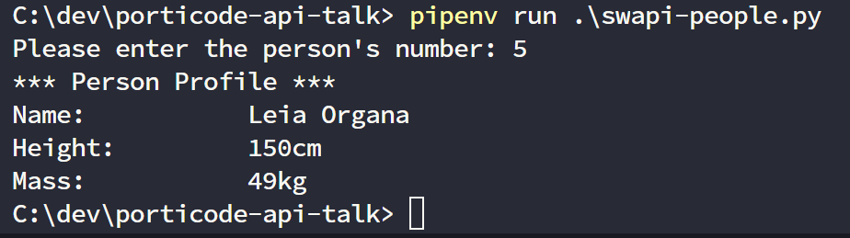
Making use of this in code: python style
You may not have used Python before, so that’s ok!
Demo now, and then you can try this yourselves after the Python workshop Simon is running this afternoon.
Code is only a few lines.
We use the requests library, which you can install using pip. This will make much more sense after your Python workshop later!
Sample code available on GitHub so that you can try it later

Slide 12
Thanks for listening!
Any questions?

